Slide 1

External Project Presentation of Computer Networking(CSE 3034) on Vulnerability Scanning in System/Web Applications
Presented by
DEBRAJ MANDAL(2141013068)
UTTAMASHA(2141021007)
SWAYAM MISHRA(2141013089)
MOUSUMI PRADHAN(2141016264)
JAGADANANDA MISHRA(2141013090)
Supervisor
Dr. Arabinda Sahoo
(Associate Professor)
Department of Computer Science and Engineering
Institute of Technical Education & Research (FET)
Siksha ‘O’ Anusandhan Deemed to be University, Bhubaneswar
Jan, 2024

Slide 2
Contents
Introduction
Problem statement
Methodology
Implementation
Result and Interpretation
Conclusion

Slide 3
Introduction
Development of Java-based tool for vulnerability scanning in LAN networks and web apps
Inspired by Nmap functionalities for systematic identification of security vulnerabilities
Tool prompts user inputs (URLs/IPs) to initiate scans through Java program
Aims to enable proactive vulnerability identification and fortification against threats
Provides simplified, user-friendly interface leveraging Java's capabilities for cybersecurity enhancement

Slide 4
Problem Statement
I. Problem Overview
Creating a Java-based tool for vulnerability scans in LAN networks and web apps.
Establishing smooth user interaction via console input for triggering scans.
Translating user inputs into comprehensive vulnerability scans similar to Nmap.
Presenting results in an accessible format for effective vulnerability management.
II. Constraints
Functionality Scope: Limitations in replicating Nmap's extensive functionalities in Java.
Scan Depth: Potential limitations in conducting exhaustive system scans.
NSE Scripts: Difficulty in translating all Nmap Scripting Engine (NSE) scripts.
Network Protocol Coverage: Challenges in covering diverse network protocols.

Slide 5
Methodology
Vulnerability Scanning Algorithm
- Input: User-provided URI/URL/IP Address
- Output: Vulnerability scan results
1. NetworkScanner Java program execution initiation.
2. Console interface input acceptance for URI/URL/IP Address.
3. Storage of user input as the 'target' for vulnerability scanning.
4. Nmap command construction via ProcessBuilder:
a. Setting Nmap executable path and required flags (-sV, -O, --script "vulners").
b. Inclusion of the 'target' from user input as a parameter in the Nmap command.
5. Error output redirection to regular output stream for unified display.
6. Initiation of Nmap process through executing the constructed command.
7. Scanning initiation:
a. Output (results) reading of the Nmap scan.
b. Display of each scan output line in the console interface.
c. Repeating until all output lines are processed.
8. End of scan:
i. Closure of the output reading mechanism.
9. Exception Handling:
ii. IOException handling during process execution:
a. Stack trace printing for debugging facilitation.
10. Program Termination: NetworkScanner Java program termination.

Slide 6
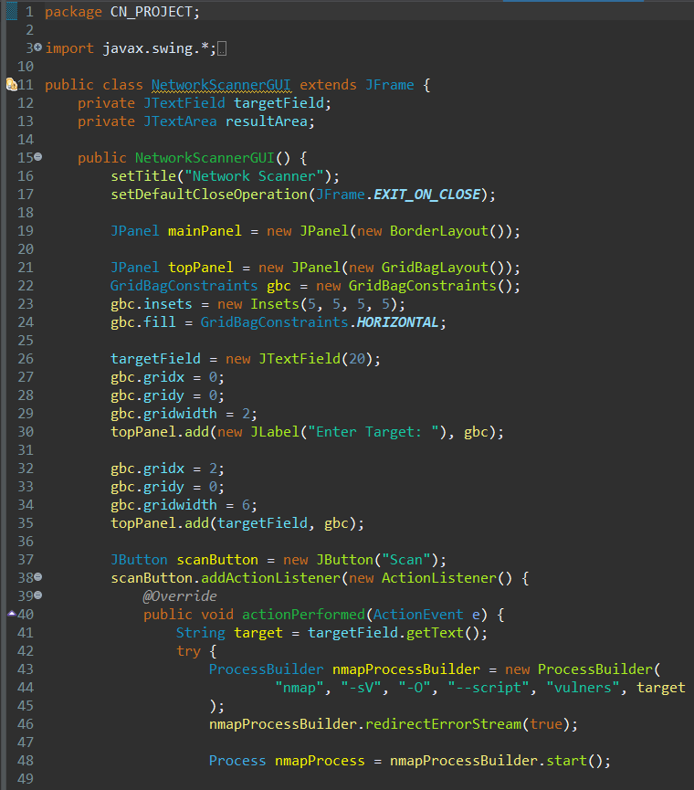
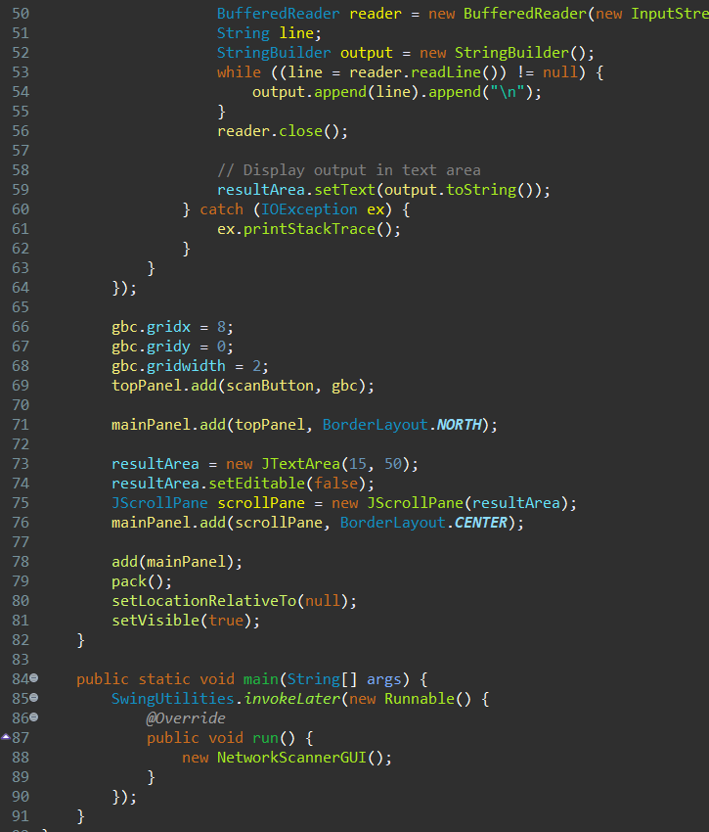
Implementation

Slide 7
Implementation
The `NetworkScannerGUI` class sets up a graphical user interface (GUI) for initiating network scans through a Java program. Here are the main components and functions of this class:
1. Components:
- `JTextField targetField`: Field for entering the target (URI/URL/IP Address) to scan.
- `JTextArea resultArea`: Area to display the scan results.
- `JButton scanButton`: Button to trigger the scanning process.
2. Constructor NetworkScannerGUI():
- Sets up the GUI elements, layout, and initializes the main panels.
- Creates the input field for the target and the scan button.
- Defines the action listener for the scan button to execute the scan process.
3. ActionListener for `scanButton` (Action Performed):
- Retrieves the target input from `targetField`.
- Attempts to execute an Nmap scan command using `ProcessBuilder` based on the provided target.
- Redirects error streams for unified output.
- Reads the output of the Nmap scan and displays it in the `resultArea`.
4. `main()` Method:
- Initializes the GUI by invoking `NetworkScannerGUI()` within the `SwingUtilities.invokeLater()` method, ensuring GUI elements are created and handled on the Event Dispatch Thread.
The GUI essentially allows users to input a target (URI/URL/IP Address), initiate a scan by clicking the "Scan" button, and displays the scan results in a text area within the window.

Slide 8
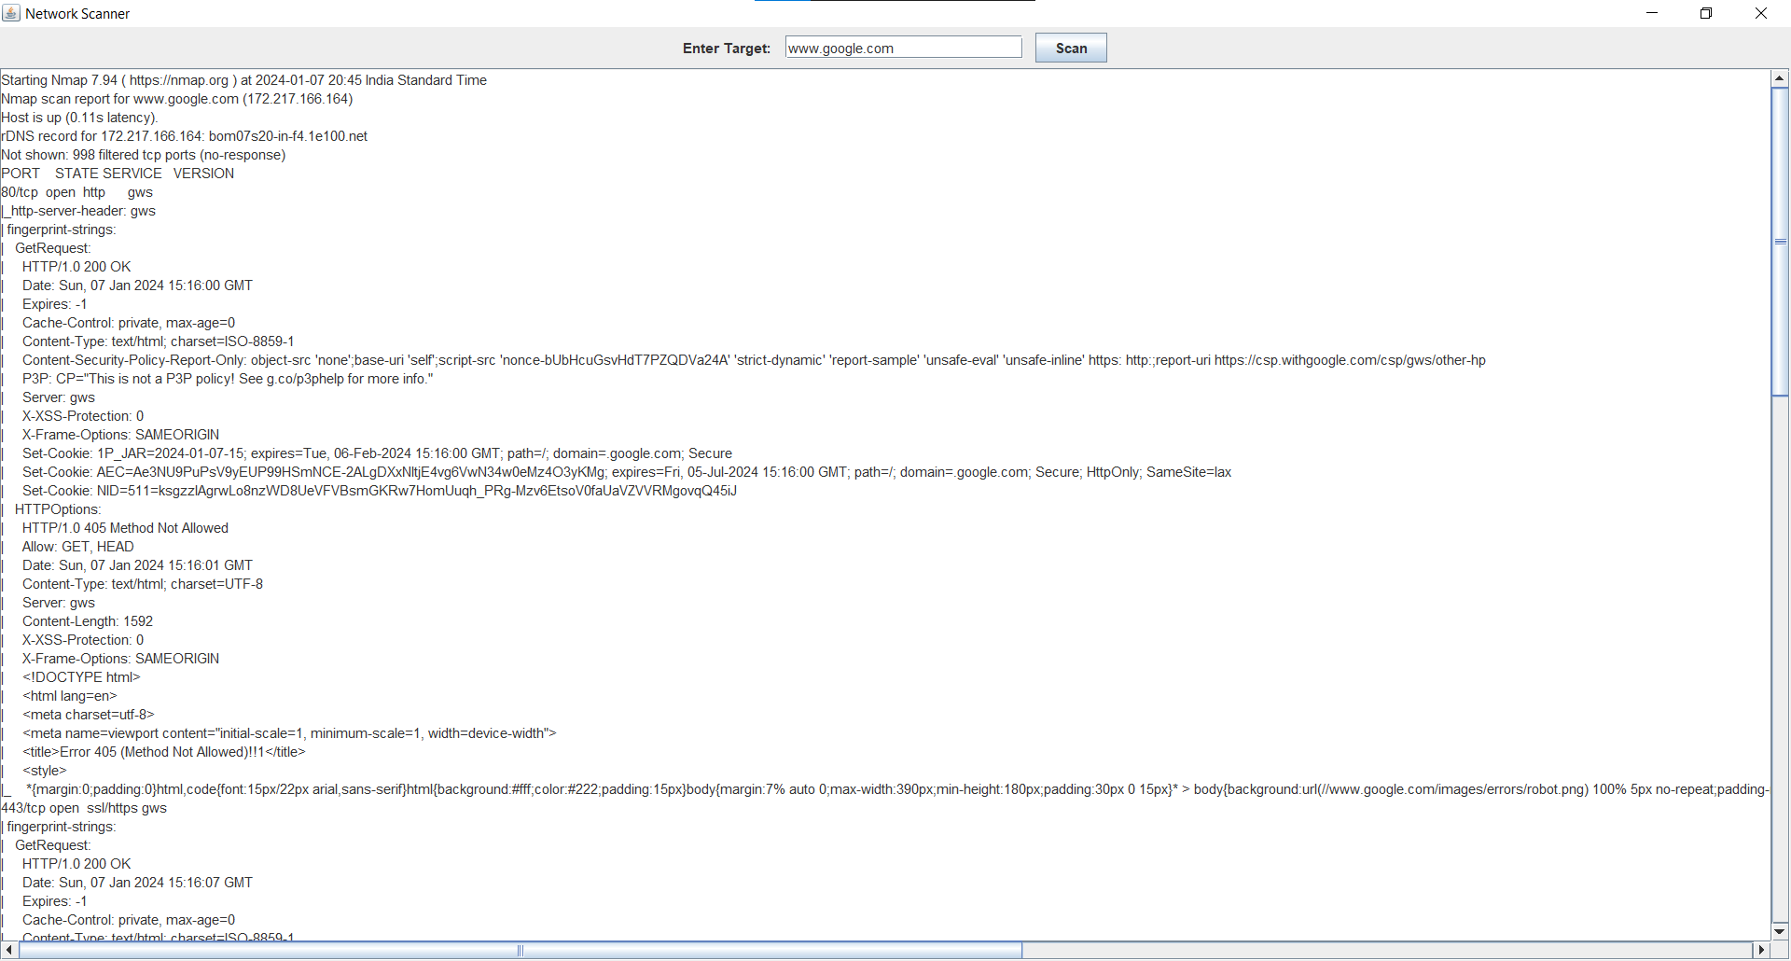
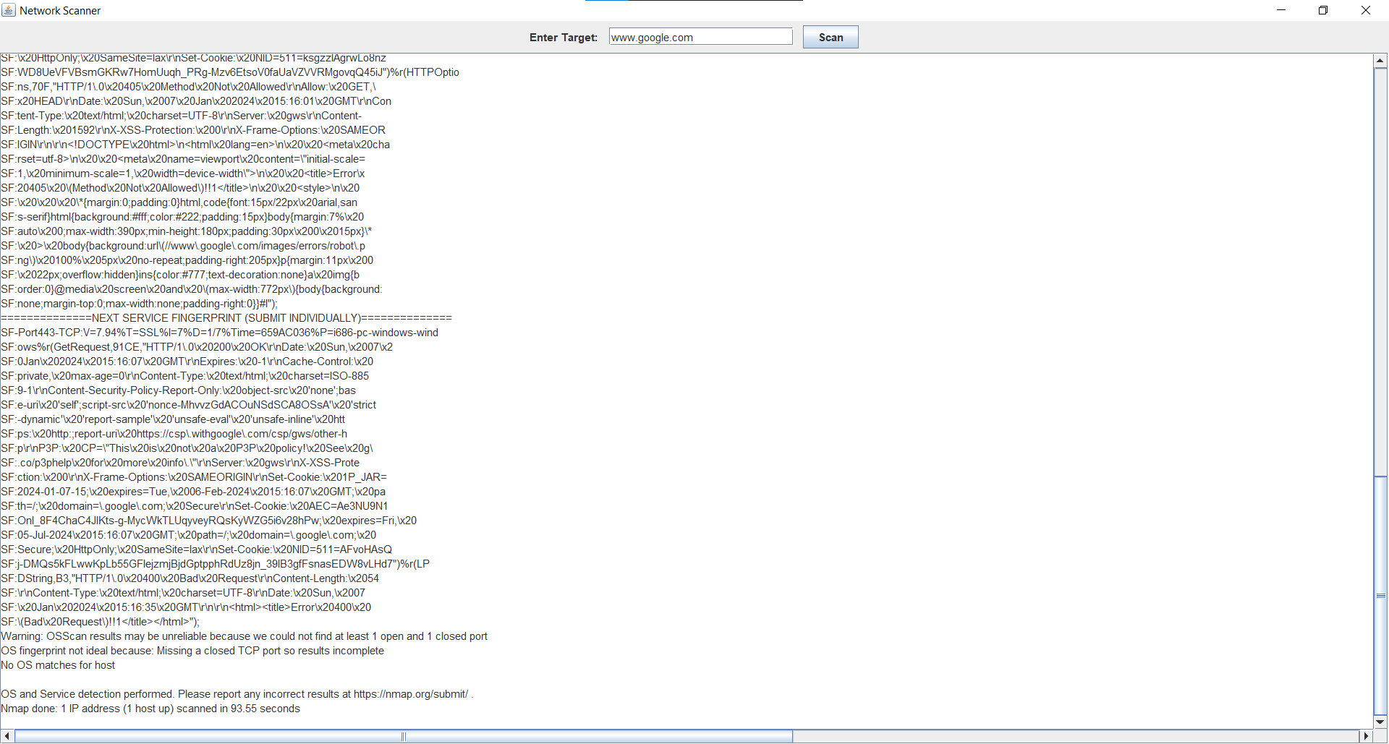
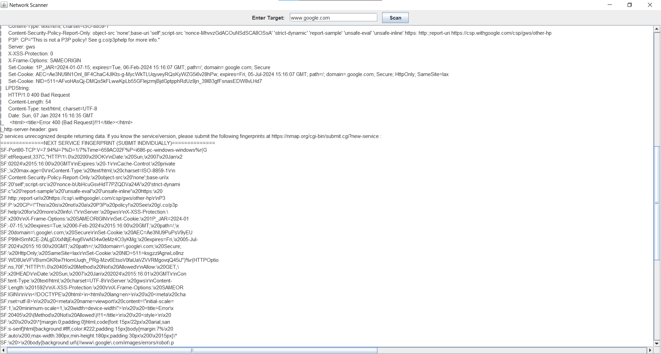
Result and Interpretation
The results will provide:
Nmap Version and Start Time
Host Information
Open Ports and Services:
HTTP(S) Responses:
Service Identification
Warnings and Summary
Scan Completion

Slide 9
Conclusion
In conclusion, our exploration of vulnerability scanning tools, including NMAP and Nessus, underscores their crucial role in enhancing system security. Understanding, exploring, and customizing tools using Java Programming provide a holistic approach to addressing vulnerabilities.
The live NMAP demo and result explanation showcased real-time capabilities, while the benefits of Java Programming emphasized flexibility and efficiency. Identifying vulnerabilities and regular security scans are key strategies for proactive risk mitigation, compliance adherence, and continual security enhancement.
As we navigate the cybersecurity landscape, the insights gained equip us with essential tools and strategies for safeguarding against evolving threats.

Slide 10
References
[1] A. S. Tannenbaum, "Computer Networks," Pearson India.
[2] H. Harold, "Java Network Programming," O’Reilly, Shroff Publishers.
[3] W. Richard Stevens, "TCP/IP Illustrated, Volume 1: The Protocols," Addison-Wesley Professional.
[4] G. G. Richard Stevens, "UNIX Network Programming," Prentice Hall.
[5] D. E. Comer, "Internetworking with TCP/IP: Principles, Protocols, and Architecture," Prentice Hall.

Slide 11


Slide 12


